Slide 1

Detection of Diabetic Retinopathy using Artificial Intelligence
SARTHAK S.N.
HARSHITH
SHASHWAT SHIVAM

Slide 2

CLASSIFICATION OF DR
CAUSES OF DR
CONVENTIONAL ALGORITHMS
COMPARISION AMONG DIFFERENT CNN ARCHITECTURES
DATA PREPOCESSING
TRAINING AND TESTING
SQEEZE AND EXCITATION BLOCK
DATA AUGMENTATION
REGULARISATION
SE BLOCK
CROSS VALIDATION
LEARNING RATE SCHEDULAR
EARLY STOPPING
EXPLORATORY DATA ANALYSIS
RESULTS
CONCLUSION.

Slide 3
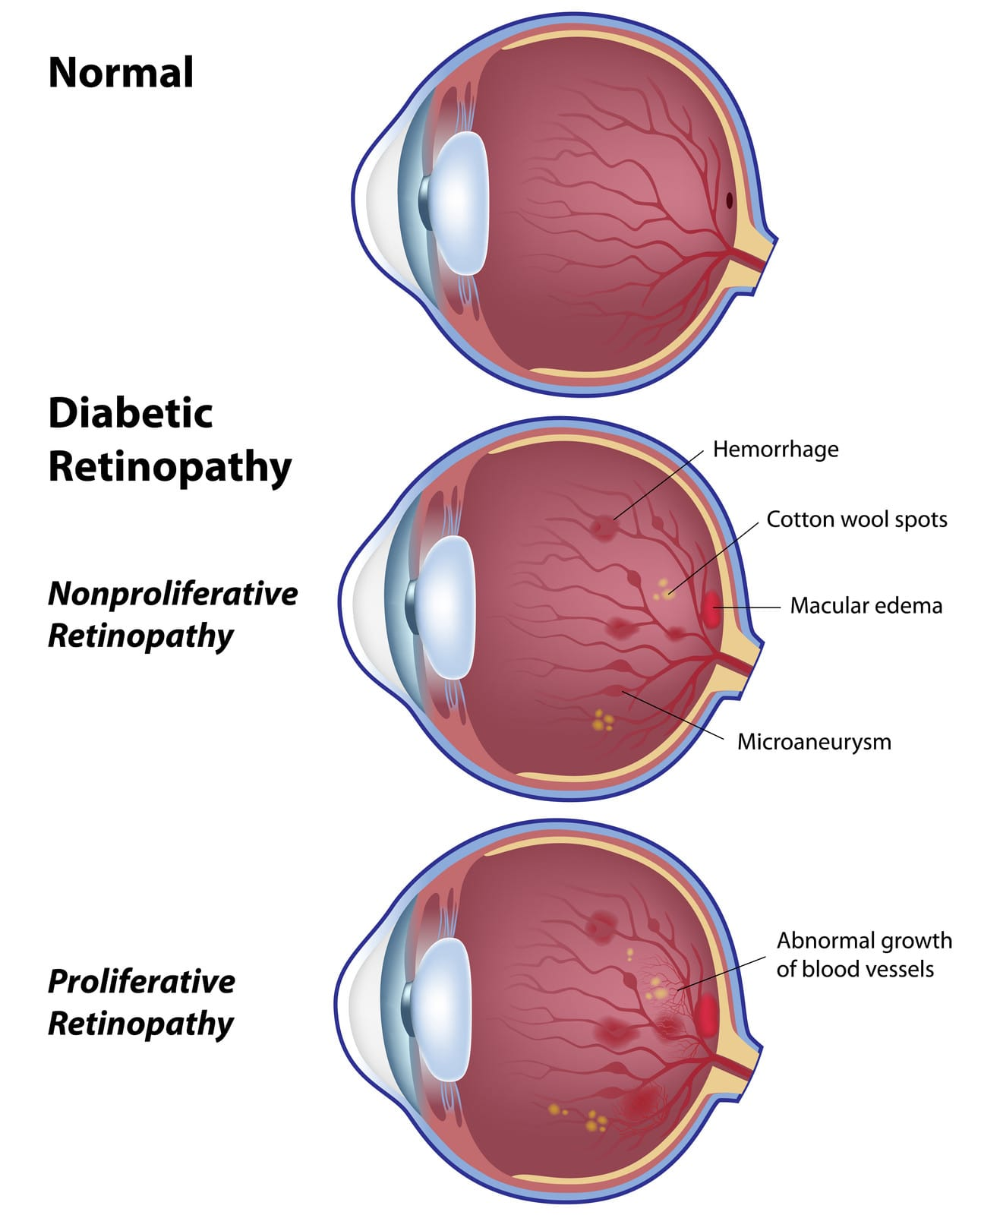
Classification of Diabetic Retinopathy(DR)
1. Proliferative Retinopathy(PR):
This is an advanced stage where abnormal blood vessels grow in the retina.
Can lead to bleeding, scarring, and retinal detachment.
2. Non-Proliferative Retinopathy (NPR):
Early stage characterized by weakened blood vessels, microaneurysms, and retinal bleeding.
Divided into mild, moderate, and severe stages based on the severity of changes.

Slide 4
Causes of Diabetic Retinopathy
Diabetic retinopathy is a diabetes-related complication that affects the eyes. The primary cause of diabetic retinopathy is long-term diabetes, especially when blood sugar levels are poorly controlled over an extended period. And it involves several factors as follows:
High Blood Sugar (Hyperglycemia):Prolonged periods of elevated blood glucose levels can damage the small blood vessels (capillaries) in the retina. The retina is the light-sensitive tissue at the back of the eye, essential for vision.
Damage to Retinal Blood Vessels : The tiny blood vessels in the retina can become weakened, leading to microaneurysms (small bulges in the vessel walls) and leakage of blood into the retinal tissue.
Ischemia (Poor Blood Supply):As the disease progresses, some areas of the retina may experience reduced blood supply (ischemia), leading to the formation of new, abnormal blood vessels in an attempt to compensate for the lack of oxygen.

Slide 5
Severity of Diabetic Retinopathy
The severity of diabetic retinopathy is categorized into different stages based on the extent and characteristics of the retinal damage. The stages include:
Mild Non-Proliferative Retinopathy (NPDR):Microaneurysms may be present, but overall, the retina shows only mild damage.
Moderate NPDR : More severe changes in the blood vessels, such as blockages and increased numbers of microaneurysms.
Severe NPDR : Significant blockages in blood vessels, increased numbers of microaneurysms, and signs of poor blood supply (ischemia).
Proliferative Diabetic Retinopathy (PDR):The advanced stage marked by the growth of abnormal blood vessels (neovascularization) on the retina or optic nerve head. These vessels are fragile and can lead to bleeding into the vitreous gel, causing vision problems and potentially retinal detachment.

Slide 6
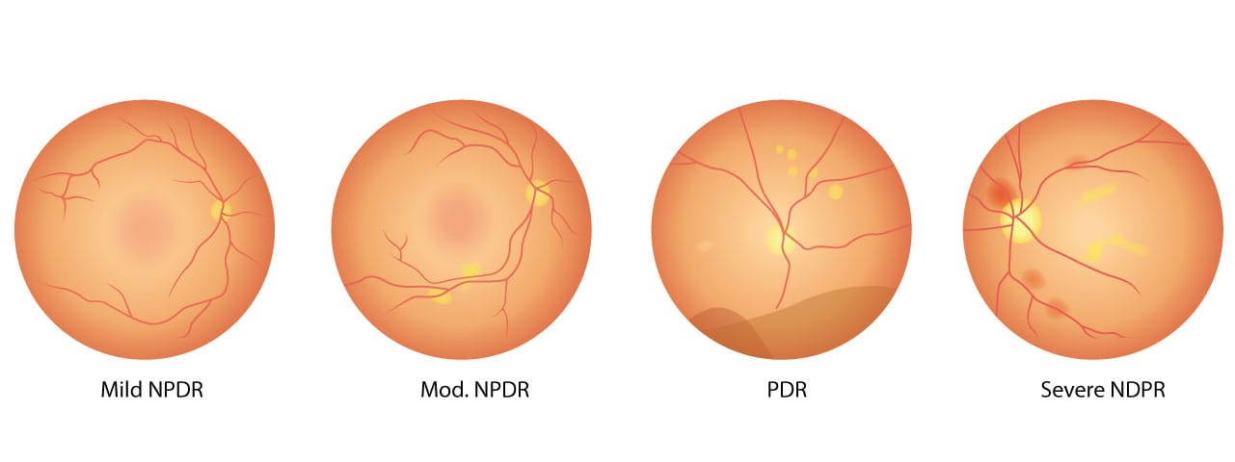

Slide 7

Detailed literature review of conventional algorithms
Subjectivity and Inter-Observer Variability
Time-Consuming Manual Grading
Limited Sensitivity to Early-Stage
Dependence on Image
Risk of Missed Diagnoses

Slide 8
Literature review –Machine Learning algorithm & Deep learning algorithm
Deep learning algorithms, particularly Convolutional Neural Networks (CNNs), have shown significant success in detecting diabetic retinopathy (DR). These algorithms leverage the power of neural networks to automatically learn hierarchical representations from image data. Some popular deep learning approaches for detecting diabetic retinopathy are:
1)Google's Inception-v3:Google's Inception-v3 is a deep neural network architecture that has been applied to diabetic retinopathy detection. It's known for its efficiency in handling large-scale image datasets.
2)ResNet (Residual Networks):ResNet is a deep learning architecture with residual connections, allowing the training of very deep networks. This type of architecture has been successful in image classification tasks, including diabetic retinopathy detection.
3)DenseNet (Densely Connected Convolutional Networks) DenseNet connects each layer to every other layer in a feed-forward fashion. It has shown advantages in terms of parameter efficiency and training speed. DenseNet architectures have been explored for diabetic retinopathy detection.

Slide 9
4)EfficientNet : EfficientNet is designed to provide better performance with fewer parameters. It achieves this by balancing network depth, width, and resolution. It has been used in various image classification tasks, including diabetic retinopathy.
5)SqueezeNet : SqueezeNet is a lightweight CNN architecture that aims to reduce the number of parameters without sacrificing performance. It can be useful in scenarios where computational resources are limited.
6)Customized CNN Architectures : Researchers often design customized CNN architectures tailored for diabetic retinopathy detection. These models may include additional preprocessing steps or incorporate attention mechanisms to focus on relevant regions in the images.

Slide 10
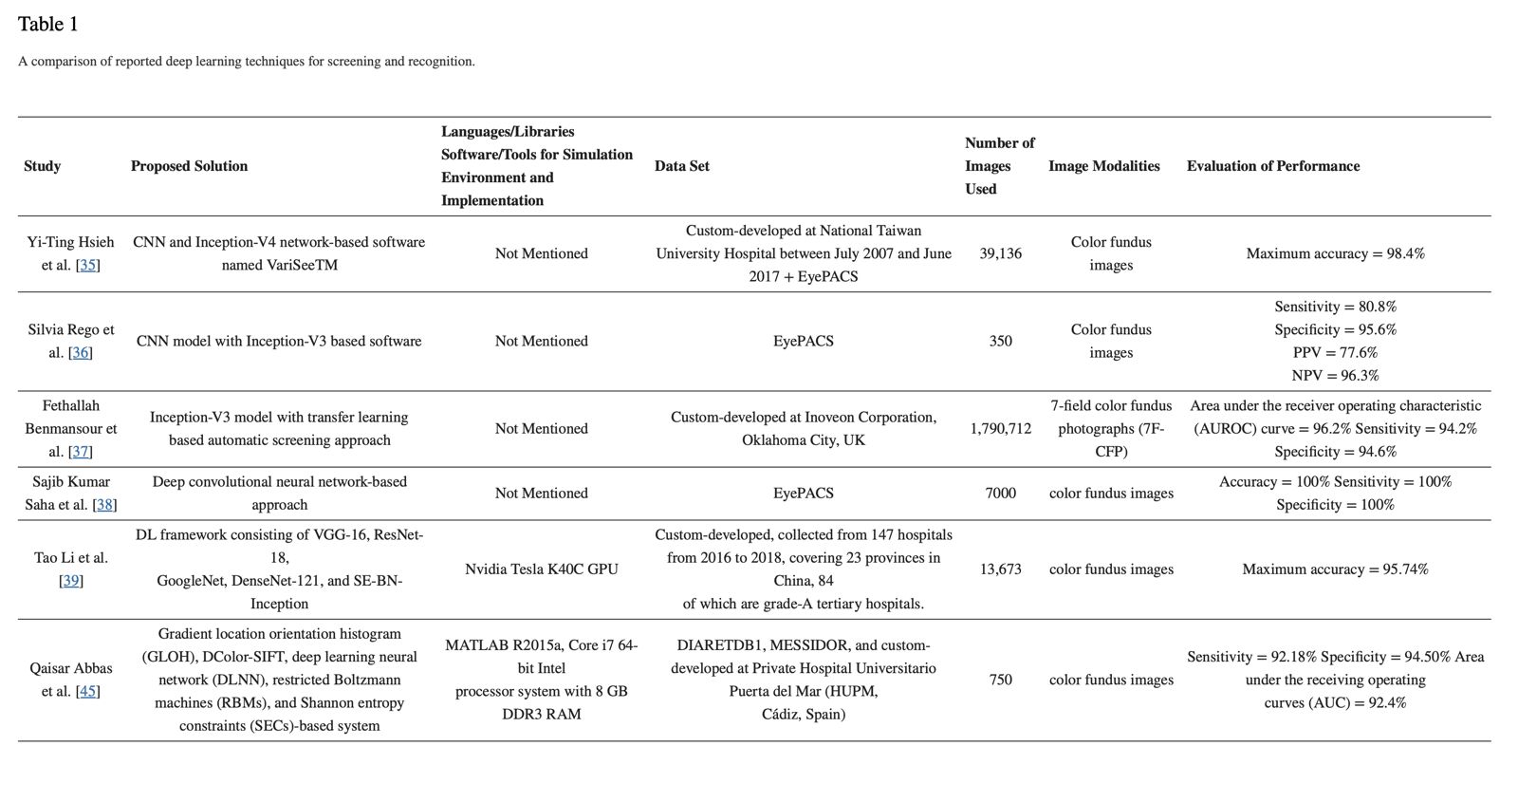

Slide 11
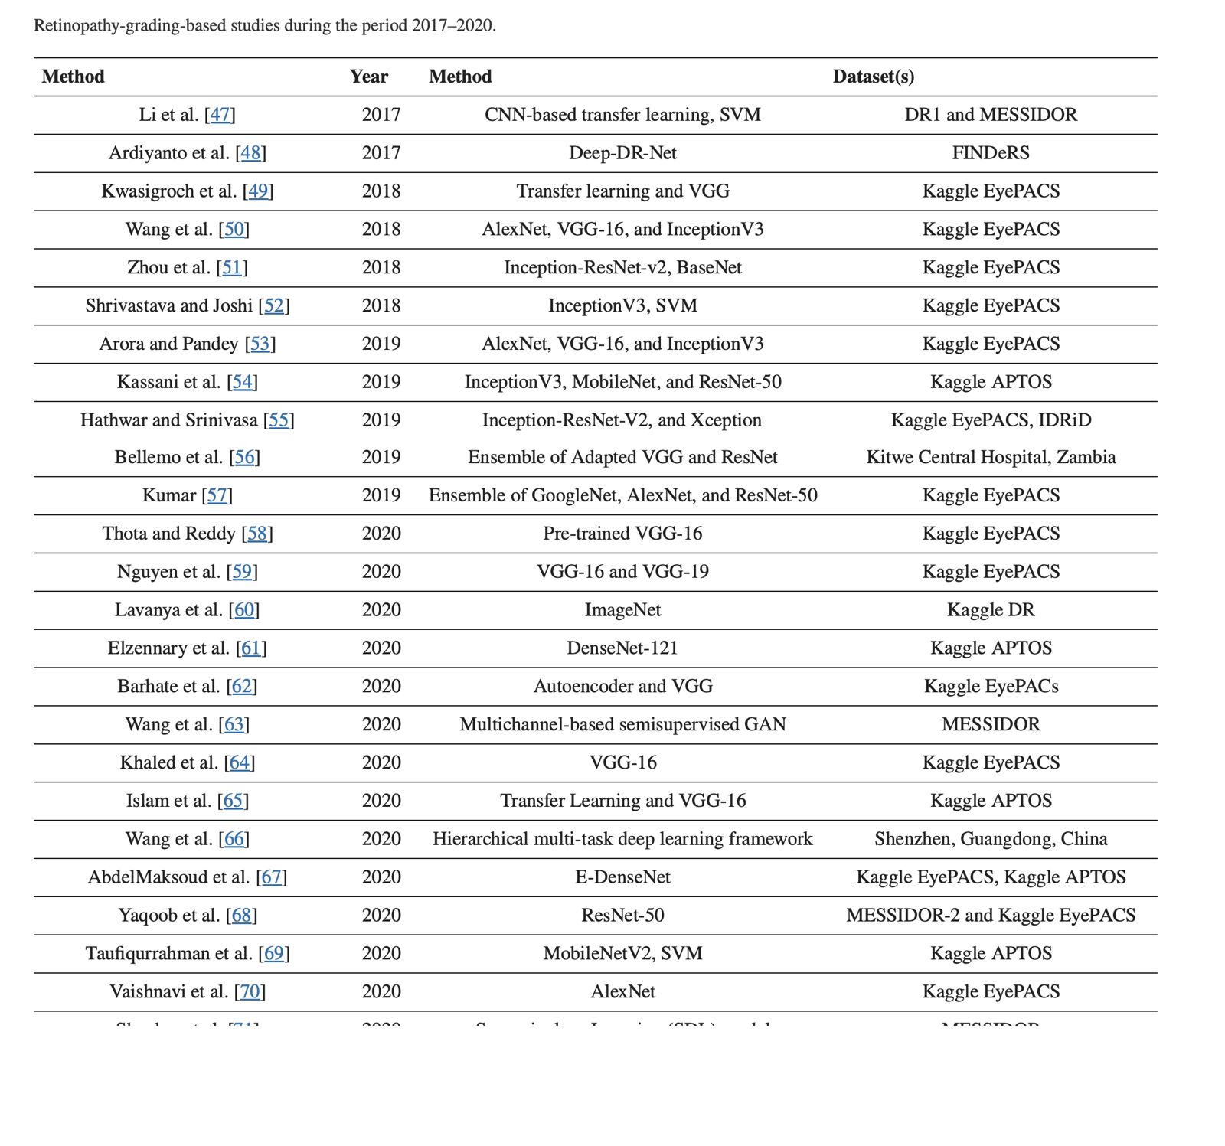

Slide 12
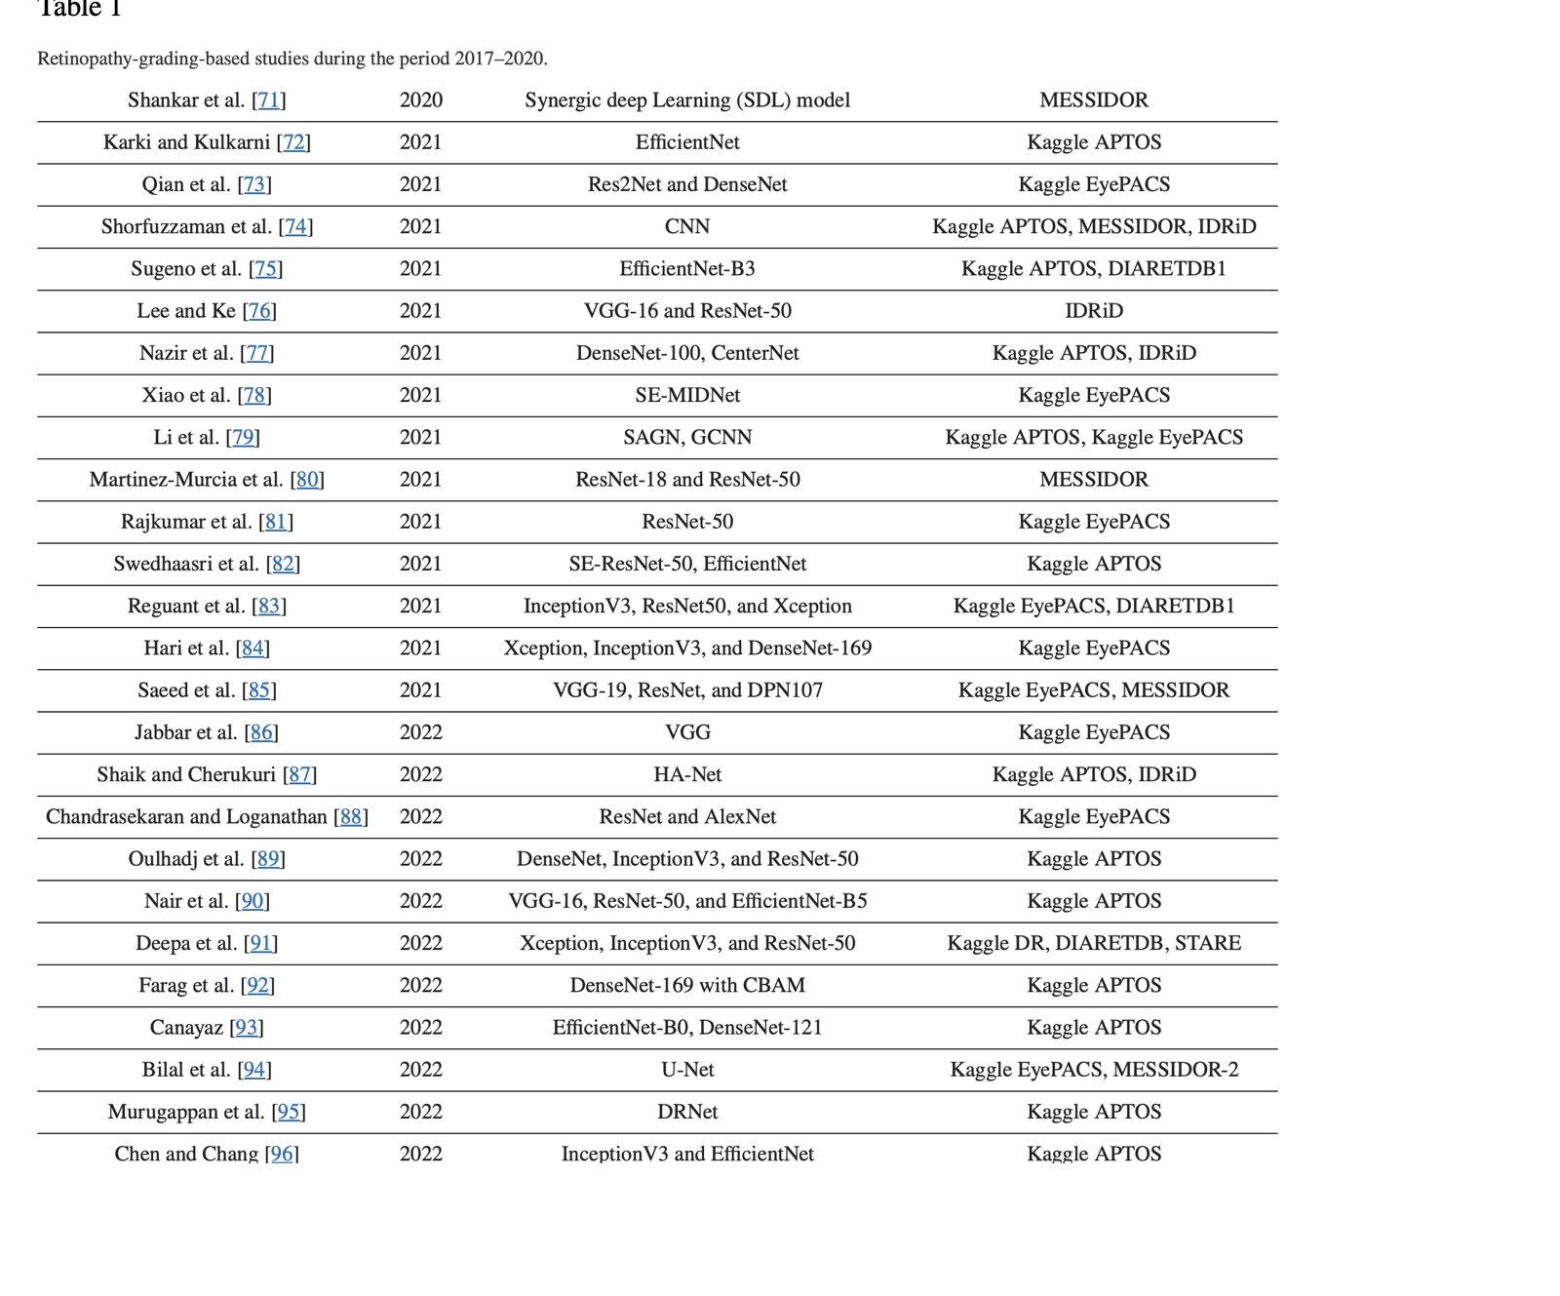

Slide 13
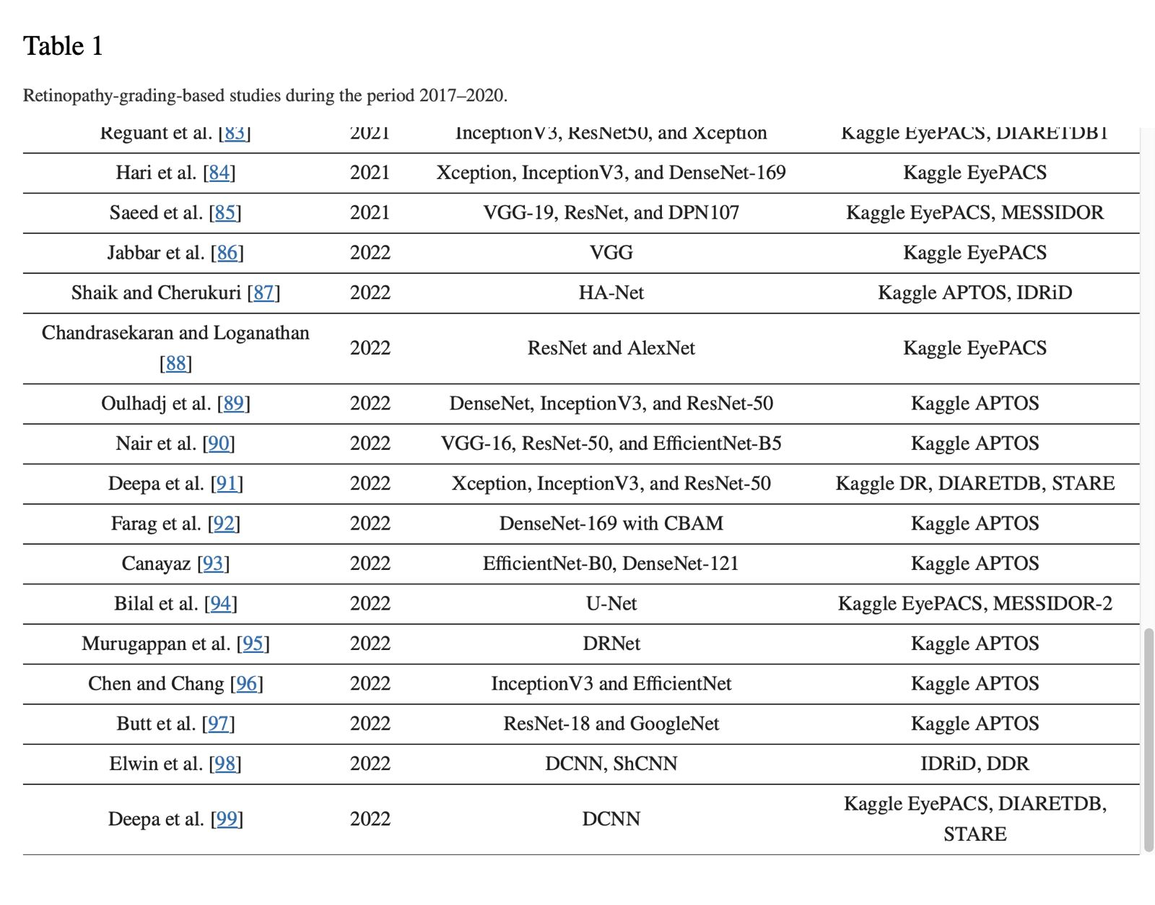

Slide 14
Performance parameters of both ML/DL algorithms
The performance of a Convolutional Neural Network (CNN) for detecting diabetic retinopathy is typically evaluated using various performance metrics. These metrics provide insights into how well the model is performing on a given dataset. Some common performance parameters are:
Accuracy : Accuracy is a basic metric that measures the overall correctness of the model. It is the ratio of correctly predicted samples to the total number of samples.
Sensitivity (Recall or True Positive Rate):Sensitivity measures the ability of the model to correctly identify positive cases. In the context of diabetic retinopathy detection, it represents the percentage of actual positive cases (patients with diabetic retinopathy) correctly identified by the model.
Specificity (True Negative Rate):Specificity measures the ability of the model to correctly identify negative cases. It represents the percentage of actual negative cases (patients without diabetic retinopathy) correctly identified by the model.
Precision (Positive Predictive Value):Precision is the ratio of correctly predicted positive observations to the total predicted positives. It indicates how many of the predicted positive cases are actually positive.

Slide 15
F1 Score : The F1 score is the harmonic mean of precision and recall. It provides a balanced measure between precision and recall. F1 score is useful when there is an uneven class distribution.
Area Under the Receiver Operating Characteristic (ROC) Curve (AUC-ROC):AUC-ROC is a useful metric for binary classification problems. It measures the area under the curve of the ROC plot, which represents the trade-off between sensitivity and specificity across different threshold values.
Area Under the Precision-Recall (PR) Curve (AUC-PR):AUC-PR is another evaluation metric that is particularly useful when dealing with imbalanced datasets. It measures the area under the precision-recall curve.
Confusion Matrix : A confusion matrix provides a tabular summary of the number of true positives, true negatives, false positives, and false negatives. It is valuable for understanding the specific types of errors made by the model
Interpretability and Explainability : While not a traditional performance metric, the interpretability and explainability of the model's predictions are crucial in medical applications. Techniques such as attention mechanisms or saliency maps can help highlight regions in the input images that contribute to the model's decision.

Slide 16

DEEP LEARNING

Slide 17
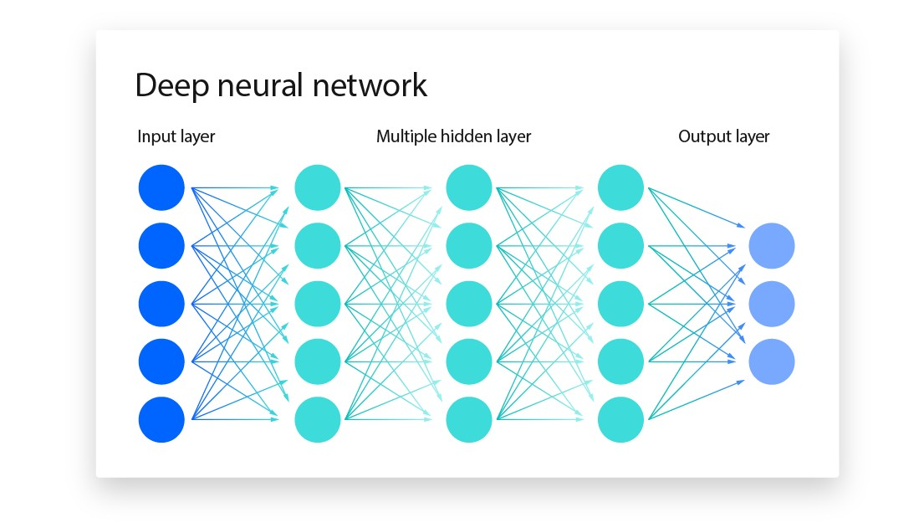
Artificial Neural network

Slide 18
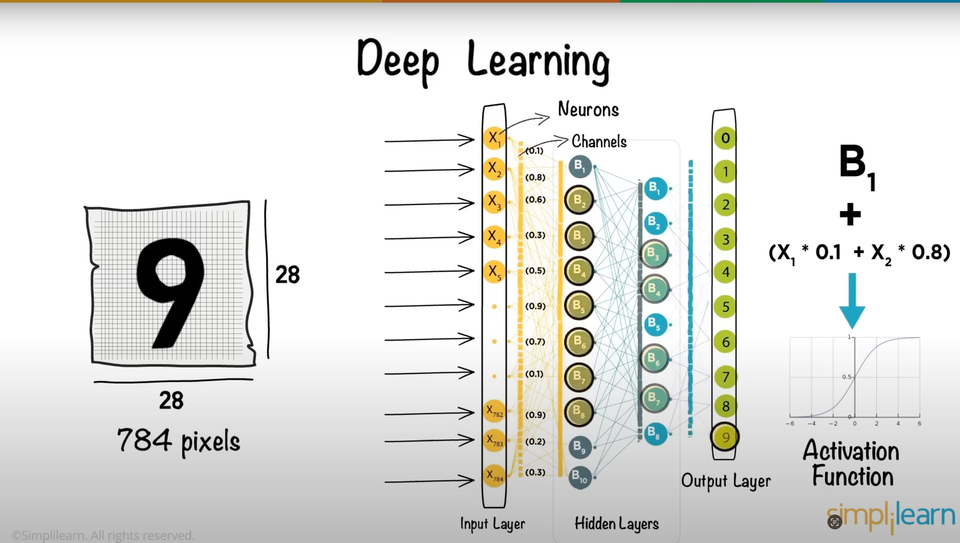

Slide 19
https://www.kaggle.com/code/kmader/ inceptionv3-for-retinopathy-gpu-hr/ notebook

Slide 20
DATA PREPROCESSING
Data preprocessing in Machine Learning refers to the technique of preparing (cleaning and organizing) the raw data to make it suitable for a building and training Machine Learning models.
Data preprocessing is the concept of changing the raw data into a clean data set.

Slide 21
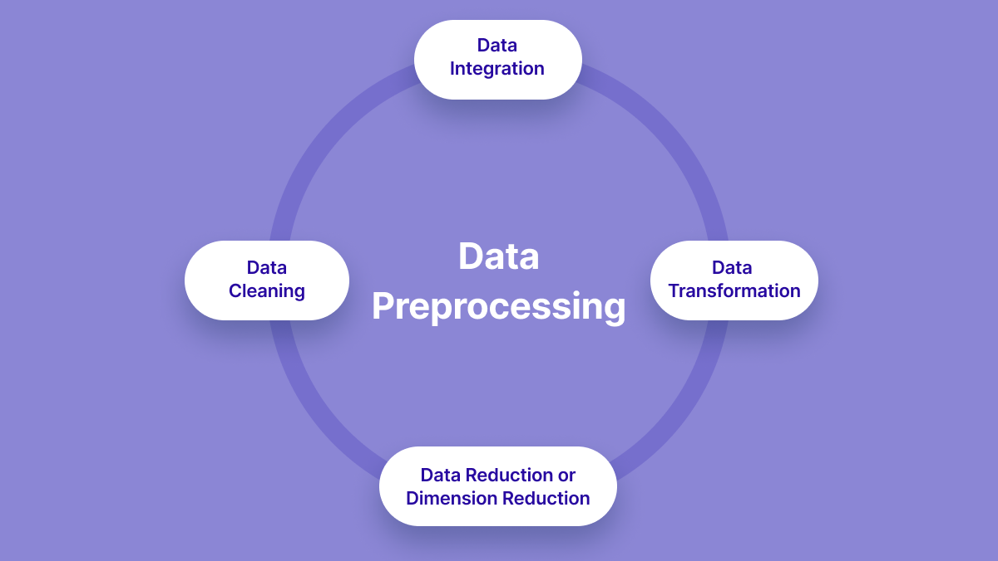

Slide 22
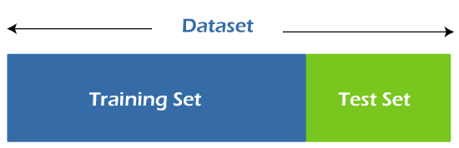
TRAININg AND TESTINg DATA SET

Slide 23
TRAINING AND TESTING DATA SET
Training :
The training data is the biggest (in -size) subset of the original dataset, which is used to train or fit the machine learning model. Firstly, the training data is fed to the ML algorithms, which lets them learn how to make predictions for the given task.
Testing :
The test dataset is another subset of original data, which is independent of the training dataset. However, it has some similar types of features and class probability distribution and uses it as a benchmark for model evaluation once the model training is completed.

Slide 24
Generative Adversarial Networks(GAN)
A generative adversarial network (GAN) has two parts:
The generator learns to generate plausible data. The generated instances become negative training examples for the discriminator.
The discriminator learns to distinguish the generator's fake data from real data. The discriminator penalizes the generator for producing implausible results.

Slide 25
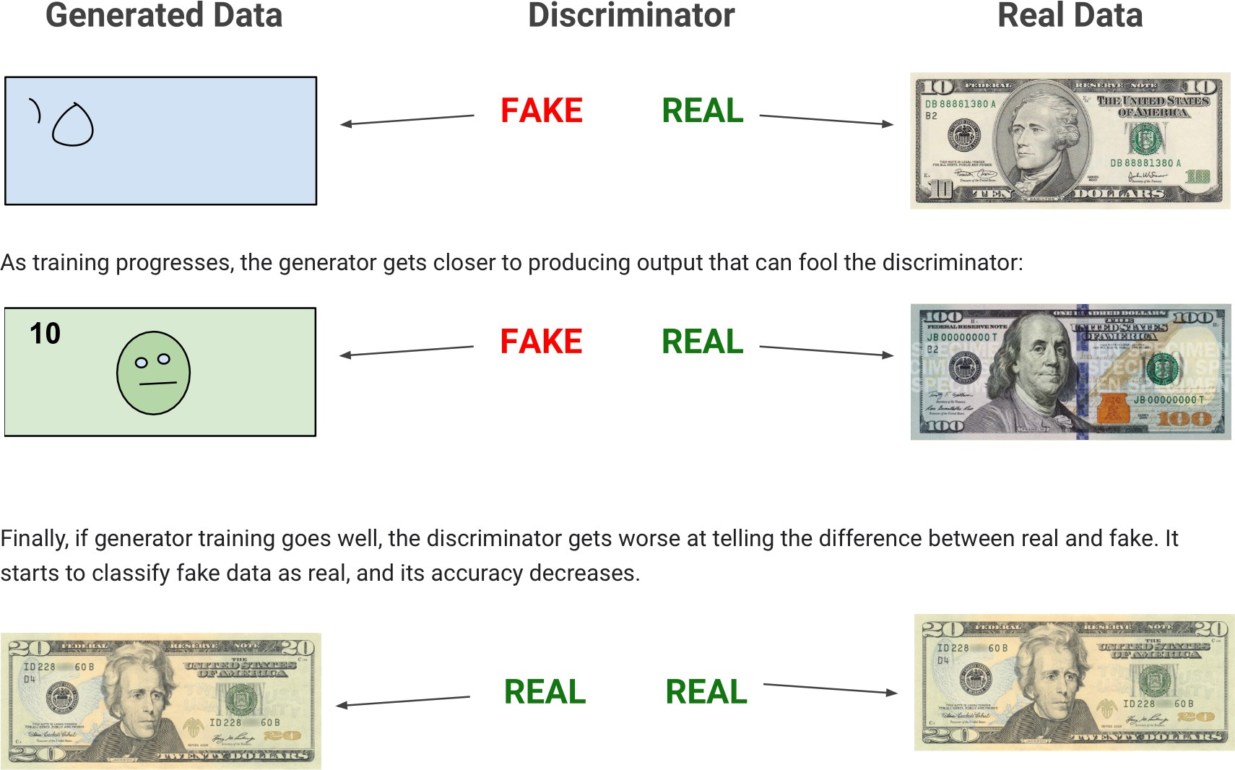

Slide 26
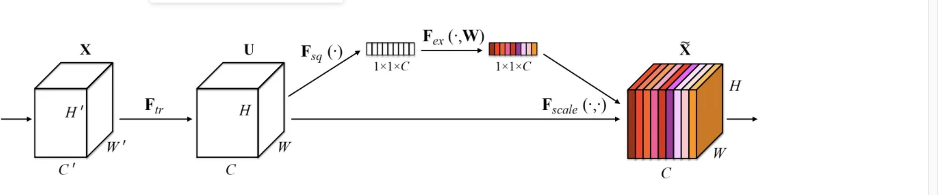
SQUEEZE AND EXCITATION NETWORKS

Slide 27
SQUEEZE AND EXCITATION NETWORK
Squeeze-and-Excitation Networks (SENets) introduce a building block for CNNs that improves channel interdependencies at almost no computational cost. They were used at this years ImageNet competition and helped to improve the result from last year by 25%. Besides this huge performance boost, they can be easily added to existing architectures. The main idea is this:
Let’s add parameters to each channel of a convolutional block so that the network can adaptively adjust the weighting of each feature map.”

Slide 28
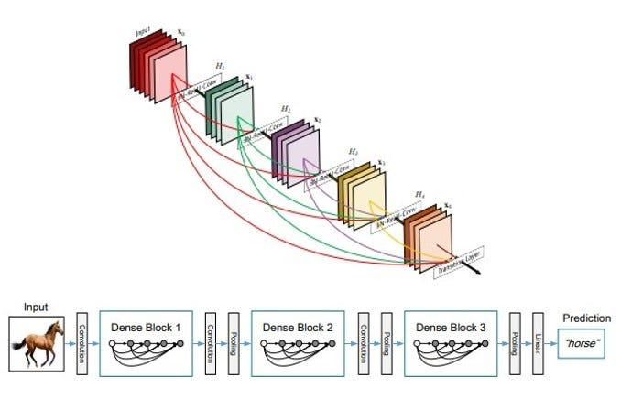
DENSENET 121
DenseNet-121 is a convolutional neural network architecture known for its dense connectivity pattern, where each layer is connected to every other layer in a feed-forward fashion. This connectivity facilitates feature reuse and enhances gradient flow throughout the network. Key features of DenseNet-121 include:
Dense Blocks: DenseNet-121 consists of multiple dense blocks, where each dense block contains a series of densely connected convolutional layers. Within each dense block, feature maps from all preceding layers are concatenated and passed as inputs to subsequent layers.
Transition Layers: Between dense blocks, transition layers are inserted to control the growth of feature maps and reduce the computational complexity of the network. Transition layers typically include a combination of convolutional and pooling operations to downsample the feature maps and adjust the number of channels.
Bottleneck Layers: Bottleneck layers, usually 1x1 convolutional layers, are employed within dense blocks to reduce the number of input channels before the main convolution operation. This improves computational efficiency and parameter sharing.
Global Average Pooling: At the end of the network, global average pooling is applied to aggregate spatial information across feature maps, resulting in a fixed-length vector representation of the entire input image. This vector is then fed into a fully connected layer or softmax layer for classification.
Dropout: Dropout regularization may be applied to mitigate overfitting by randomly setting a fraction of input units to zero during training, encouraging the network to learn more robust features and preventing co-adaptation of neurons.

Slide 29
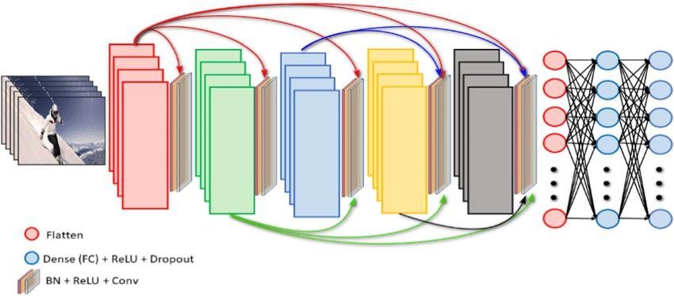
DenseNet-201
DenseNet-201 consists of multiple dense blocks interleaved with transition layers.Each dense block contains a series of densely connected convolutional layers.Transition layers are used to control the growth of feature maps and reduce the computational complexity of the network by employing convolutional layers followed by average pooling to downsample the feature maps
.Key Components:
Bottleneck Layers:Bottleneck layers, typically 1x1 convolutional layers, are employed within dense blocks to reduce the number of input channels before the main convolution operation, improving computational efficiency.
Growth Rate:The growth rate parameter determines the number of feature maps generated by each layer within a dense block.densenet201:DenseNet-201 usually uses a higher growth rate compared to earlier versions, allowing for more feature maps to be generated at each layer.
Global Average Pooling:At the end of the network, global average pooling is applied to aggregate spatial information across feature maps, producing a fixed-length vector representation of the entire input image.This vector is then fed into a fully connected layer or softmax layer for classification.
Regularization:Dropout regularization may be applied to mitigate overfitting by randomly setting a fraction of input units to zero during training, forcing the network to learn more robust features.
Batch Normalization:Batch normalization is used to stabilize and accelerate the training process by normalizing the activations of each layer, mitigating issues such as vanishing or exploding gradients.

Slide 30
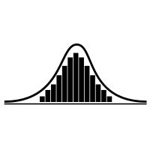
GAUSSIAN PREPROCESSING
Gaussian preprocessing, also known as Gaussian normalization or standardization, is a data preprocessing technique commonly used in machine learning to rescale the features of a dataset to have a mean of zero and a standard deviation of one, following a Gaussian (normal) distribution.
Compute Mean and Standard Deviation: For each feature (or column) in the dataset, calculate its mean and standard deviation across all samples in the dataset.
Normalize Features: Subtract the mean of each feature from all values in that feature, and then divide by the standard deviation. This process ensures that each feature has a mean of zero and a standard deviation of one.

Slide 31
GAUSSIAN PREPROCESSING CODE
# Define custom preprocessing function for Gaussian noise
def apply_gaussian_noise(image):
noise = np.random.normal(loc=0, scale=0.1, size=image.shape)
return image + noise

Slide 32

DATA AUGMENTATION
Data augmentation is a technique used in machine learning and deep learning to artificially increase the size of a training dataset by applying various transformations to the existing data samples. These transformations create new variations of the original data, helping the model to generalize better and improve its performance.
Some common data augmentation techniques for images are:
Rotation: Rotating the image by a certain angle.
Translation: Shifting the image horizontally or vertically.
Scaling: Resizing the image while preserving its aspect ratio.
Flipping: Mirroring the image horizontally or vertically.
Shearing: Tilting the image along its axis.
Zooming: Zooming in or out of the image.
Color Jittering: Randomly changing the brightness, contrast, saturation, or hue of the image.

Slide 33
DATA AUGMENTATION CODE
# Data augmentation and preprocessing
datagen = ImageDataGenerator( rescale=1./255, preprocessing_function=apply_gaussian_noise,
rotation_range=20,
width_shift_range=0.1,
height_shift_range=0.1,
shear_range=0.2,
zoom_range=0.2,
horizontal_flip=True)

Slide 34
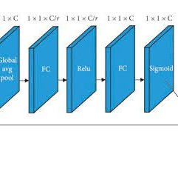
SQUEEZE AND EXCITATION OPTIMISATION
The Squeeze-and-Excitation (SE) block is a component commonly used in convolutional neural network (CNN) architectures, particularly in models designed for image classification tasks. It enhances the representational power of CNNs by adaptively recalibrating the feature maps in a channel-wise manner, focusing on informative features and suppressing less relevant ones

Slide 35
SQUEEZE AND EXCITATION CODE
# Add custom top layers with Seblock
x = base_model.output
x = GlobalAveragePooling2D()(x)
x = squeeze_excite_block(x) # Add SE block

Slide 36

ADDITIONAL DENSE LAYER INCORPORATION
# Additional Dense layers for further feature extraction
x = Dense(1024, activation='relu')(x)
x = BatchNormalization()(x)
x = Dropout(0.5)(x)
x = Dense(512, activation='relu')(x)
x = BatchNormalization()(x)
x = Dropout(0.5)(x)
# Output layerpredictions = Dense(num_classes,activation='softmax')(x)

Slide 37

I've added additional Dense layers after the SE block for further feature extraction.
Dropout regularization is applied after each Dense layer to prevent overfitting.
Batch normalization layers are added after each Dense layer to stabilize and accelerate the training process.
Gaussian noise preprocessing technique is applied using a custom preprocessing function within the ImageDataGenerator.

Slide 38
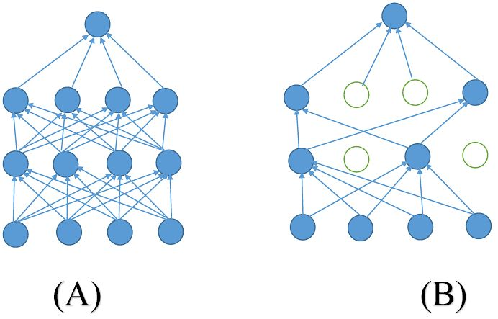

DROP OUT REGULARISATION
Dropout regularization is a technique commonly used in neural networks to prevent overfitting.
During Training: In each training iteration, dropout randomly selects a fraction of neurons to be dropped out with a certain probability, typically between 0.2 and 0.5. This means that the output of these neurons is set to zero, and their connections to subsequent layers are temporarily removed.
During Testing: During testing or inference, dropout is not applied, and all neurons are active. However, the weights of the connections are scaled by the dropout probability to ensure that the expected output remains the same as during training.

Slide 39
DROP OUT REGULARISATION CODE
x = Dropout(0.5)(x)

Slide 40
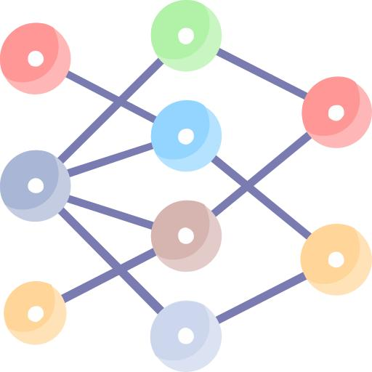
L2 REGULARIZATION
L2 regularization, also known as weight decay, is a common technique used in machine learning and neural networks to prevent overfitting. It works by adding a regularization term to the loss function during training, which penalizes large weights in the model.

Slide 41
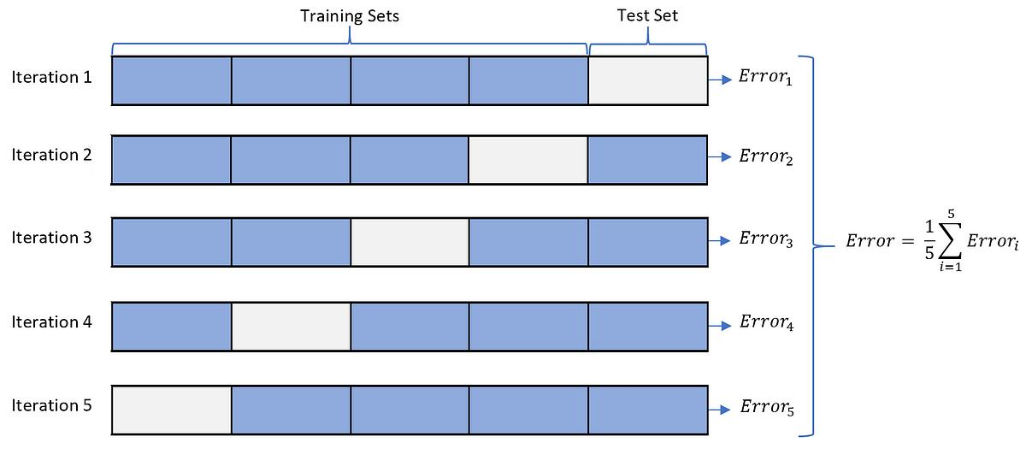
K CROSS VALIDATION
K-fold cross-validation is a widely used technique in machine learning for model evaluation and selection, particularly when dealing with limited data. It involves partitioning the dataset into k equally sized subsets, or "folds." The model is trained and evaluated k times, with each fold used once as the validation set while the remaining k-1 folds are used as the training set. This process allows for more robust validation compared to a single train-test split.
Partitioning: The dataset is divided into k subsets of approximately equal size.Iterative Training and Validation: For each iteration, one of the k subsets is retained as the validation set, while the remaining k-1 subsets are used as the training set.
Model Training: The model is trained on the training set, and its performance is evaluated on the validation set using a chosen evaluation metric (e.g., accuracy, precision, recall, F1-score).Performance Metrics: The performance metrics are recorded for each iteration.
Average Performance: After all iterations are complete, the performance metrics are averaged to obtain a more reliable estimate of the model's performance.

Slide 42
LEARNING RATE SCHEDULER
Learning rate scheduling is an optimization technique used during training to adjust the learning rate over time. In the context of InceptionV3 or any deep learning model, including a learning rate scheduler can help improve training stability, convergence speed, and final performance.

Slide 43
LEARNING RATE SCHEDULER CODE
# Learning rate schedule function
def lr_schedule(epoch):
initial_learning_rate = 0.001
decay_rate = 0.1
decay_steps = 5
lr = initial_learning_rate * decay_rate ** (epoch / decay_steps)
return lr
# Define learning rate schedule callback
lr_scheduler = LearningRateScheduler(lr_schedule)

Slide 44
EXPLORATORY DATA ANALYSIS
Exploratory Data Analysis (EDA) is an essential step in the data analysis process, where analysts explore and summarize key characteristics of the dataset to understand its structure, patterns, and potential relationships. EDA involves various techniques and visualizations to gain insights into the data before applying more complex analytical methods. Overall, EDA is a crucial step in the data analysis workflow, providing a foundation for subsequent modeling, hypothesis testing, and decision-making. It helps analysts understand the data's characteristics, uncover patterns and relationships, and make informed decisions based on data-driven insights.

Slide 45
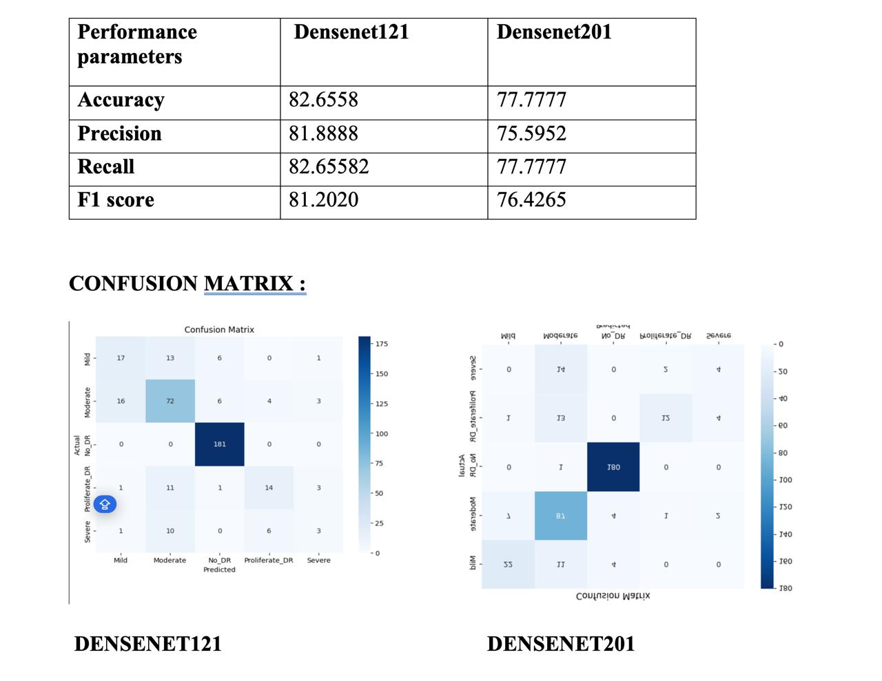

Slide 46

THANK YOU

